Slide 1




Robotic Process Automation

Slide 2
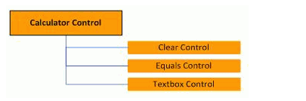
OpenSpan Studio | OpenSpan Application Integration
Overview:-
OpenSpan Studio lets you interrogate applications to expose the underlying objects and uniquely identify each object. You can then use these objects to build automations and monitor application events. To interrogate an application, you use OpenSpan Adapters. Interrogation results in the creation of controls corresponding to the interrogated application targets. OpenSpan uses translators and factories to enable communication between application targets and their platforms.
Adapters:-
The OpenSpan platform lets developers integrate applications at the desktop through their user interfaces. To integrate an application, OpenSpan uses adapters to inject code within the target application that directly interacts with the application’s objects. OpenSpan does not require the target application to be recompiled or modified in any way. OpenSpan supports a number of platforms and application control types including Windows common controls, Internet Explorer HTML controls, Java and .NET. An adapter is a component that lets users integrate with an application built upon a specific platform (Windows, Web, and so on.) by interrogating the application to produce metadata describing the application. Adapters have accessible properties, methods, and events.
Controls:-
When an application object is interrogated in OpenSpan studio, a representation of that object is created. That representation is known as a Control. OpenSpan organizes controls in a hierarchy. For example integrating the Calculator application and interrogating the Clear button, Equals button, and Results text box.

Slide 3
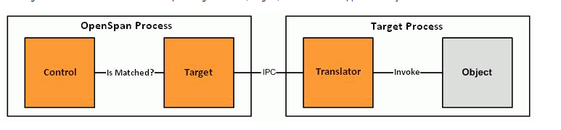
Targets A target is an Openspan object that corresponds directly with an application object. Whereas controls represent the virtual application object that does not change between runs of the application, targets represent the actual application object that exists within the application at any given moment. Targets are created and destroyed when application objects are created and destroyed. Targets are platform specific and encapsulate the necessary logic to automate and monitor application objects. Thus, the text box control can interact with any target that implements the text box interface, such as a Windows text box target, a Java text box target or an HTML text box target.
Translators
A translator is a unit of injected code that enables Openspan to automate and receive events from an application object. Targets communicate directly with translators using the Openspan IPC layer. Most of the time translators are objects, although in some cases translators can just be a single module or static class that interacts with all supported objects. Translators do not require any modifications or recompilation of the target application. Openspan automatically injects translators into a target application and attaches them to the appropriate application object. Translators are typically written in the same language as the objects they are interacting with. Thus for example, translators for .NET controls are written in C# and translators for Java controls are written in Java. The most notable exception to this is ActiveX or COM controls, which due to their binary interface can be written in C++ regardless of whether they were originally written in Visual Basic or another language. Translator assemblies are included in Deployment packages.
Factories
Factories are controls that enable OpenSpan Studio to talk to specific platforms. These factories interact with Brokers as injected at the platform level (.NET, Java, Active X and so on). Factories appear in Object Explorer and are automatically detected by OpenSpan Studio.

Slide 4
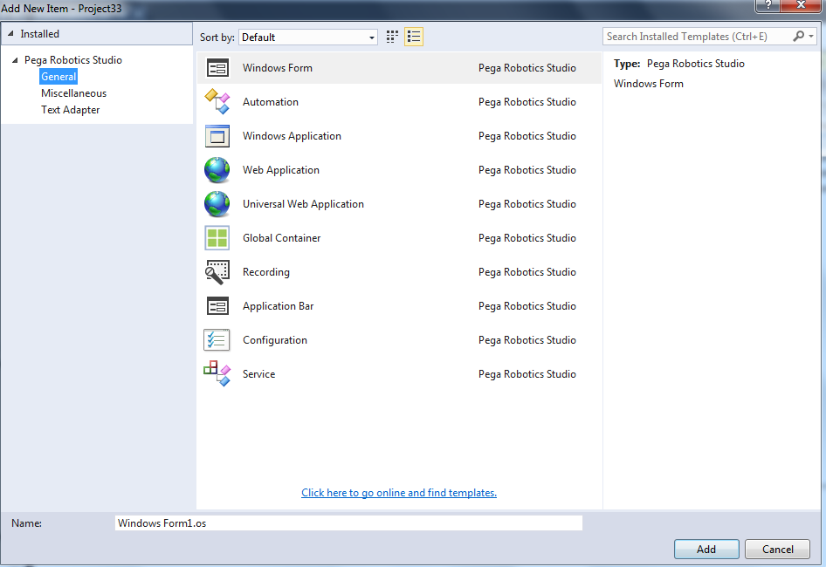
Types of adapters
General:-
General adapters can be used to automate the web and windows application.

Slide 5
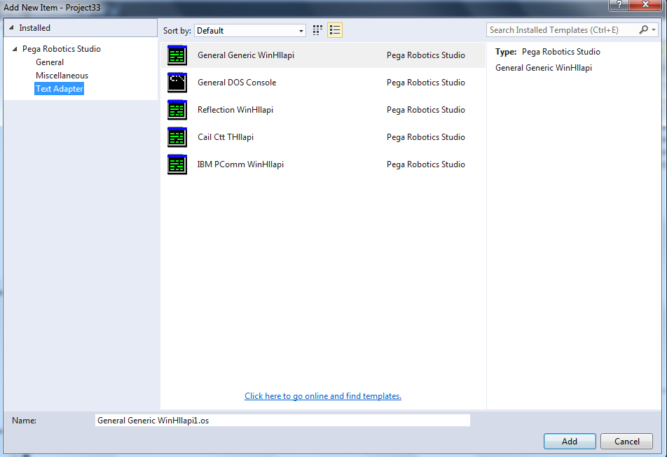
Text Adapters
Text adapters can be used to automate the mainframes and dos application.

Slide 6

Introduction to window adapters
This lesson introduces you to window adapters and properties, interrogation techniques, and project-to-project references.
After this lesson, you should be able to:
Describe common adapter properties.
Define interrogation and alternative interrogation methods.
Interrogate a windows application.
Explain project-to-project references.
Create a project-to-project reference between projects.

Slide 7
Window Adapters properties
When a developer is ready to add another application to a solution, the developer must first consider the type of adapter needed based on the type of application. The developer should add a new project for each new application required for the solution. Following this construct creates a reusable project for other solutions. One of the most common applications added for a new project is a Windows application.
A developer must understand how a Windows application performs and functions in order to configure the adapter properties for use in the project and the solution. The following adapter properties apply to a Windows application:
Path
TargetPath
HookChildProcesses
StartMethod
StartOnProjectStart
WorkingDirectory
Arguments
HideApplicationAtRuntime

Slide 8
Window Adapters properties
Path property:
Enter the full path in the Path property and the executable file name when the application runs from the same installation folder of the program. The adapter requires the Path property completed.
Here is an example:
C:\Program Files\OpenSpan\CRM Setup\CRM.exe
If the application is in the system path, enter the application file name without the full path. Here is an example:
CRM.exe
The Path property does not support links (lnk), wildcards, or Regex text entries. If you are deploying a solution where the target application runs in different folders on the desktops, you can use:
Different solution configurations
The Folder sub-property under the Path property
The Folder property allows you to select a system folder and file location for the installed application directory.

Slide 9
Window Adapters properties
TargetPath property :
The TargetPath property references an application launched as the result of one or more other processes (applications) occurring first. The Path in the TargetPath property refers to the executable that starts the target application.
To use the Path/TargetPath relationship, you must change the StartMethod property from Start to StartAndWait. Using the Path/TargetPath configuration, you cannot interrogate the Path application. You can only interrogate the TargetPath application.
Note : Java-based applications use this configuration often.

Slide 10
Window Adapters properties
HookChildProcesses property :
The HookChildProcesses property configures the solution to integrate with an application and any application launched from that application. Set the property to True when:
One application starts other applications
Both parent and spawned applications are required for the solution
As a result, Studio must “hook” into, or, integrate with, each application process.
StartMethod property :
The StartMethod property determines how the Path application starts. Options include
Option | Description
Start | Tells Studio to launch and hook the application defined by the Path property after the adapter starts. This is the default.
StartAndWait | Tells Studio to launch the application identified in the Path property after the adapter starts, wait for the TargetPath application to launch, and then hook the TargetPath application. Note: Studio does not hook the Path application; thus, you cannot interrogate or automate the Path application.
MonitorAll | Tells Studio to wait for the Path application to run and then hooks the application. In this case, starting the adapter does not cause the Path application to launch. The Path application launches independently after the adapter starts (for example, from an external application, or manually). Once the application launches, Studio hooks the application. When using the MonitorAll, you can omit the full path when specifying the application executable in the Path property and enter the executable file name. Note: Using MonitorAll lets the adapter to remain running if the Path application shuts down because of an application error or the end-user closing the application. When re-starting the application through an automation or by the end-user, Studio will hook the application.

Slide 11
Window Adapters properties
StartMethod property :
The StartMethod property determines how the Path application starts. Options include:
Start : Tells Studio to launch and hook the application defined by the Path property after the adapter starts. This is the default.
StartAndWait : Tells Studio to launch the application identified in the Path property after the adapter starts, wait for the TargetPath application to launch, and then hook the TargetPath application. Note: Studio does not hook the Path application; thus, you cannot interrogate or automate the Path application.
MonitorAll : Tells Studio to wait for the Path application to run and then hooks the application. In this case, starting the adapter does not cause the Path application to launch. The Path application launches independently after the adapter starts (for example, from an external application, or manually). Once the application launches, Studio hooks the application. When using the MonitorAll, you can omit the full path when specifying the application executable in the Path property and enter the executable file name.
Note: Using MonitorAll lets the adapter to remain running if the Path application shuts down because of an application error or the end-user closing the application. When re-starting the application through an automation or by the end-user, Studio will hook the application.

Slide 12
Window Adapters properties
StartOnProjectStart property :
Use the StartOnProjectStart property to start the adapter when the solution or project starts. The default setting for this property is True. The adapter may or may not launch the associated Path or TargetPath applications, depending on the StartMethod property.
If StartOnProjectStart is False, you must start the adapter first in an automation. When you set the StartOnProjectStart property to False, the Path and/or TargetPath applications do not launch when the project starts, regardless of the associated adapter StartMethod value.
Pega recommends leaving the default setting for those applications required to run when the solutions runs. A common usage of this property is to control the login process and application start up time for end-users.
Working directory property :
Studio populates this field with the location of the working directory property. In this case, the working directory is the same value as the Path property value. Modify the working directory to point to the supporting installation files when different from the install directory of the executable file.

Slide 13
Window Adapters properties
Arguments :
Use the Arguments property to enter command-line arguments required for starting the application associated with the adapter. For example, you could enter the name of a file to launch when the application launches. You can also use this property to specify the Java class names for Java applications.
HideApplicationAtRuntime property :
Set the HideApplicationAtRuntime property to true to hide the application during project runtime. To show the application, call the Show method on the adapter. You should use this method sparingly. Instead, develop options such as progress bars or grayed-out applications to notify the user when an automation or process completes.

Slide 14
Window Adapters Exercise
Exercise: Adding a windows adapter
Scenario :
Based on the business case, you have successfully added the Customer Information window and the needed controls to display a customer account data. Now, you are ready to add the CRM application to your solution by creating a new project and adding a windows adapter to launch the CRM application.
Your assignment :
Now, you need to add a new Project and Windows adapter (application) to your solution. You will set the adapter properties and use the installed training CRM application for the windows application. If you have not installed the application, refer to the Before you begin lesson for instructions.

Slide 15
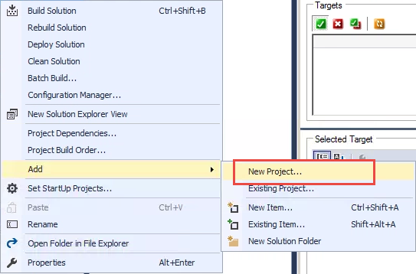
Window Adapters Exercise
Detailed steps:
Follow these steps to add a new project and a windows adapter.
In Solution Explorer, right-click the TrainingCertification solution.
Select Add > New Project.

Slide 16
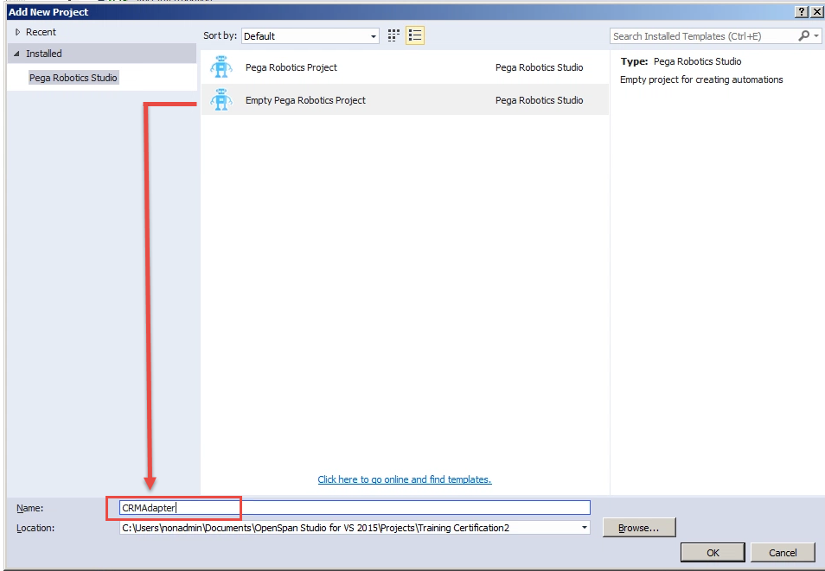
Window Adapters Exercise
3. In the Name field on the Add New Project window, enter CRMAdapter.
4. Click OK. The new project displays in the Solution Explorer.
5. Select File > Save.
6. In Solution Explorer, right-click the CRMAdapter project.

Slide 17
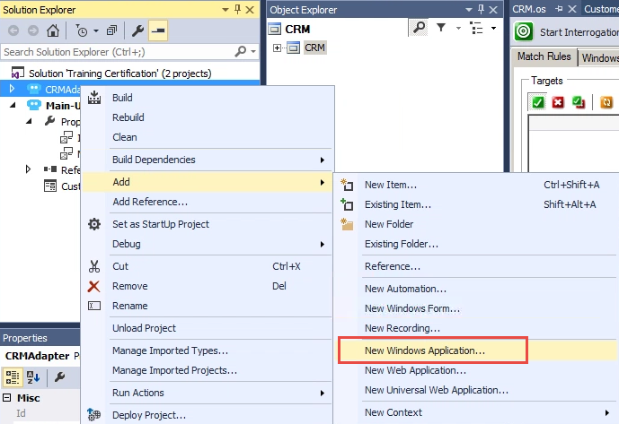
Window Adapters Exercise
7. Select Add > New Windows Application. The Add New Item dialog appears.
8. Enter CRM in the Name field.
9. Click Add. The CRM.os adapter displays in the Solution Explorer and the CRM.os designer window opens in the IDE.
10. In the Object Explorer, click the CRM object. The Properties window displays the adapter properties.
11. In the Properties window, locate the Path property.
12. Click in the blank property field. An ellipses button appears on the right of the blank property field.

Slide 18
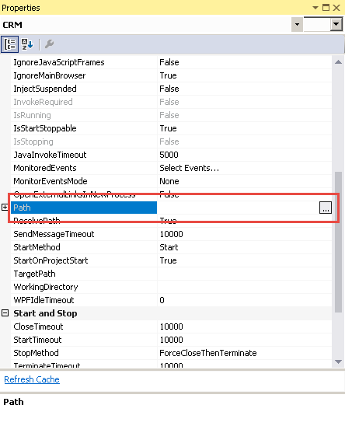
Window Adapters Exercise
13. Click the Ellipses button.
14. Browse to the installation location of the training CRM application.
15 .Click Open.
16. Select File > Save All. This saves the adapter property value edits
.

Slide 19
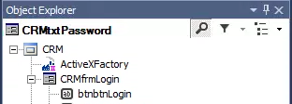
Introduction to interrogation
Interrogation is a Pega Robotic Automation function that exposes the properties of an application and its objects to Studio. Studio then uses system-defined matching rules to identify the object from other objects in the application. Studio saves the matched rules with the project. Each time the application runs within the solution, the solution compares the application’s object property values to the matched rule values of the interrogated objects. If the two values agree, Studio matches the object for use in the solution.
The interrogation process does not change any application’s underlying source code or property values. When interrogating an object, Studio creates a representation of the object in Object Hierarchy of the Object Explorer. Studio includes the parents of the interrogated object in the hierarchy as well, presenting a parent/child relationship with the adapter being the root of the hierarchy.
A green check mark on the object denotes a matched interrogated object. The green check displays only while interrogating an application.

Slide 20
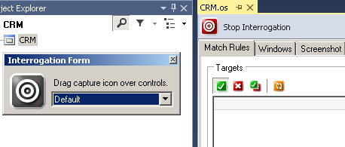
Interrogating a windows application
Since application development is not consistent, you can interrogate an application in one of three ways. You can:
Use Interrogation target
Use Create Control
Add Menu Items
Regardless of which method you use, starting and stopping the interrogation process is the same for all three.
Starting and stopping the Interrogation process :
Follow these steps to begin the interrogation process for any adapter.
Double click the adapter project item in the Solution Explorer to ensure the adapter design window is active.
In the Adapter Designer window, click Start Interrogation. The adapter starts and the application launches. The Interrogation Form window displays.

Slide 21
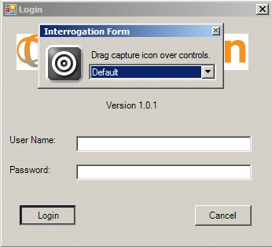
Interrogating a windows application
3. Click X on the Interrogation Form window to stop the interrogation.
Note:
You may also close the Interrogation by:
Close the application launched from the adapter.
Click Stop Interrogation on the adapter designer window.
Using the Interrogation target :
The interrogation target is the most common method of interrogating an application. Follow these steps to interrogate an application.
Start the Interrogation process.
Click the Target icon.
Holding the mouse button, drag the mouse to the desired object. A black outline highlights the object.

Slide 22
Interrogating a windows application
With the desired object highlighted, release the mouse button. The object and the object’s parents display in the Object Hierarchy with the matching green checkmarks.
Repeat step 4 for all needed objects on the application window.
Rename the interrogated objects in the Properties window.
Stop the interrogation process. The Application and Interrogation Form windows close.
Click File > Save.

Slide 23
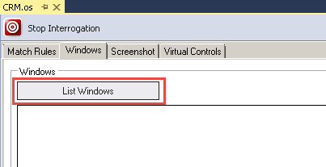
Interrogating a windows application
Using the Create Control for windows applications:
You may encounter a target that is visible but positioned so the bulls-eye icon cannot focus on the object. Follow these steps to use the Create Control interrogation method.
Start the Interrogation process.
On the Adapter Designer window, click the Windows tab.
Click the List Windows button to show all available processes within the selected adapter.
From the list of processes, click the Plus to expand the objects.
Continue expanding the different levels as needed.
Right-click on an object and select Highlight. The application appears with the selected object outlined and flashing.
Note: Using the Highlight feature is helpful when you are trying to determine the location of a control within the application interface.

Slide 24
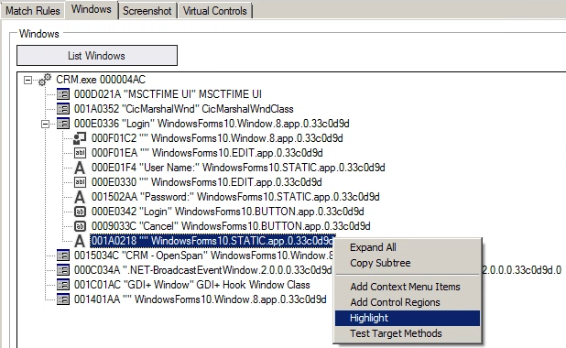
Interrogating a windows application
Return to the Windows tab on the designer window.
Right-click on the desired object and select Create Control. The control appears in the Object Explorer along with associated parents with the matching green checkmark.

Slide 25
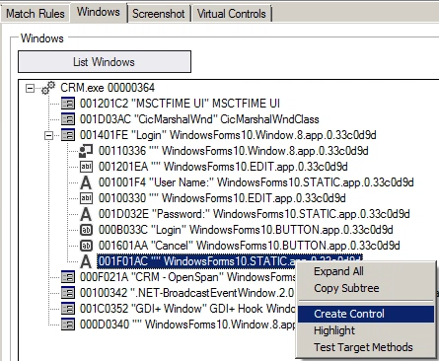
Interrogating a windows application
Repeat these steps for each object required for the solution and business case.

Slide 26
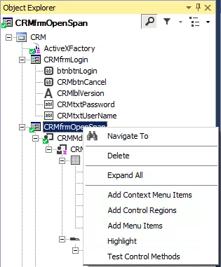
Interrogating a windows application
Using Add Menu Items:
There are times that the business case requires a menu option for the solution. Using the interrogation target disables the menu options on the application window.
Follow these steps to use the Add Menu Items.
Start the Interrogation process.
Navigate to the main windows form that contains the menu.
In the Object Hierarchy, highlight the windows form.
Right-click the windows form object in the Object Hierarchy. The object must show as matched to display the Add Menu Items option.
Repeat these steps for each object required for the solution and business case.

Slide 27
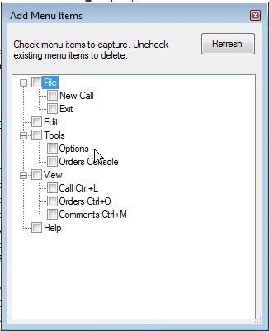
Interrogating a windows application
On the context menu, select Add Menu Items. The Add Menu Items window displays.
Select the desired menu items from the list.
Click Refresh to display dynamically created menu items after navigating to a window that creates them.
Stop the interrogation process.
As long as the main window form matches, the menu items from the form match, Studio uses the Menu Item Path match rule to match these controls. The path refers to the hierarchy of the menu options.
For example, the path for the Exit menu option is File > Exit. When using sub-options, such as Exit, in an automation, select the Exit option from the Add Menu Items window, the full path of File > Exit is not needed.

Slide 28
Exercise: Interrogating a windows application
Scenario :
The Customer Information UI contains the controls to display account information from the CRM application. The business case states that they want users to be able to display the account information and to login in to the application. The first step of gaining access to the information in CRM is interrogating the required CRM controls as well as login information.
Your assignment:
Interrogate the login controls, toolbar buttons, customer account information, and menu items in the CRM application using the three methods: Interrogation target, Create Control, and Add Menu items. Rename the objects in the Properties window during the interrogation process.
Detailed steps:
Interrogate using the Interrogation target :
With the CRM.os project item open in the Designer Window, click the Start Interrogation button. Studio launches the Training CRM application (as specified in the Path property) and opens an Interrogation Form dialog.

Slide 29
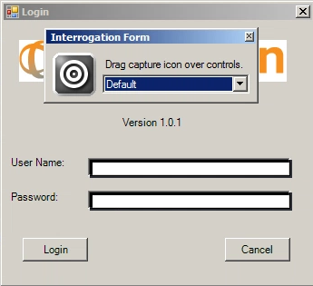
Exercise: Interrogating a windows application
Click the Target icon on the Interrogator Form dialog and drag it to the Login button.
Release the mouse button when the field has a rectangular highlight around it.
Interrogate the User Name and Password fields.

Slide 30
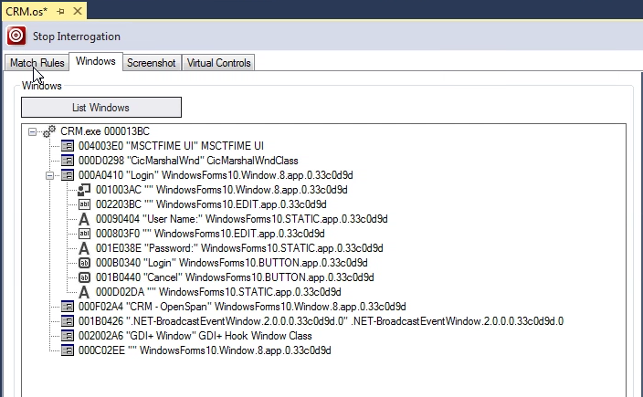
Exercise: Interrogating a windows application
Click the Windows tab on the CRM.os Designer window.
Click List Windows.
Expand the CRM.exe item in the tree view of the Windows group box.
Expand the “Login” Window Form.

Slide 31
Exercise: Interrogating a windows application
Select the last object in the list, which is the label assigned to the CRM application version information.
Right-click the Label and select Highlight.
Interrogate using Create Control:
Return to the Windows list. Right-click Label and select Create Control to add this target to the project.

Slide 32
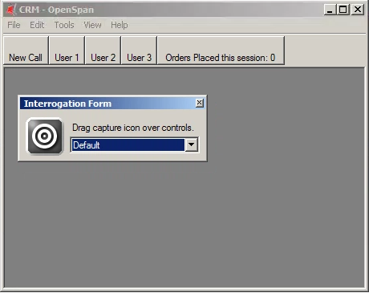
Exercise: Interrogating a windows application
Using the Object Hierarchy and Properties window, highlight each object and rename the Design Name as follows:
Click the Login button. The CRM window appears.
Interrogate these CRM buttons: New Call, User 1, User 2, and User 3.
Object Name | Design Name
Login | CRMfrmLogin
btnbtnLogin | CRMbtnLogin
lblgdilblVersion | CRMlblVersion
txttxtCredentials | CRMtxtUserName
txttxtPassword | CRMtxtPassword

Slide 33
Exercise: Interrogating a windows application
Highlight the object and rename the Design Name as follows:
Click the New Call button. This opens the New Call 1 window. Your display settings may black out the Account Number field. Change the display to Windows Classic, if desired.
Interrogate these text field targets:
Account Number
Name
Street Address City State ZIP
Object Name | Design Name
CRM_Subtraction_OpenSpan | CRMfrmOpenSpan
Toolbar1 | CRMToolBar
btnbntUser1 | CRMbtnUser1
btnbntUser2 | CRMbtnUser2
btnbtnNewCall | CRMbtnNewCall
btnbtnUser3 | CRMbtnUser3

Slide 34
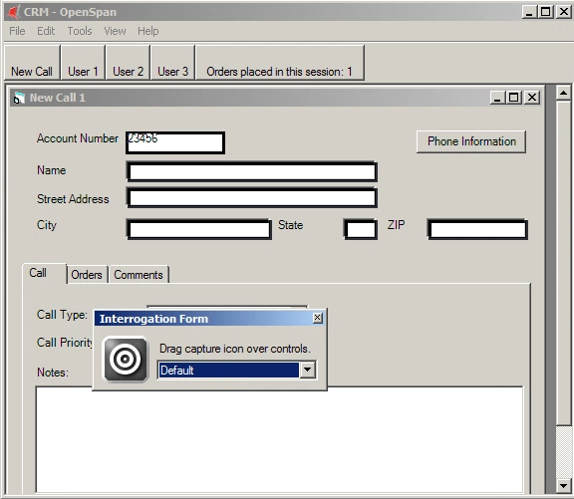
Exercise: Interrogating a windows application
City
State
ZIP
In the Object Explorer, highlight each object and rename the Design Name as follows:

Slide 35
Exercise: Interrogating a windows application
Click the Comments tab.
Interrogate the Comments field.
In the Object Explorer, highlight the object and rename the Design Name as follows:
Object Name | Design Name
MdiClient | CRMMDIClient
CRMchild | CRMChild
pnlCustomerInfo | CRMpnlCustInfo
lbllblAcctNum | CRMlblAcctNum
txttxtCity | CRMtxtCity
txttxtName | CRMtxtName
txttxtState | CRMtxtState
txttxtStreetAdd | CRMtxtStreetAdd
txttxtZip | CRMtxtZip

Slide 36
Exercise: Interrogating a windows application
Interrogate using Add Menu Items:
In Object Explorer, highlight the CRMfrmOpenSpan object.
Right-click and select Add Menu Items. The Add Menu Item window appears.
Object Name | Design Name
tabMain | CRMtabMain
tabComments | CRMtabComments
txttxtComments | CRMtxtComments

Slide 37
Exercise: Interrogating a windows application
Select Orders Console from the Add Menu Items dialog.
Click the X to close the dialog and save your selection.
Stop the interrogation process.
Click File > Save. The asterisk on the CRM.os tab disappears.

Slide 38
Exercise: Interrogating a windows application
Which tool window would you use to rename an interrogated control?
a. Object Explorer b. Properties
c. Solution Explorer d. Toolbox
The Interrogate function enables you to _________________.
a. Toolbars, Designer windows and Tool windows b. Properties, Methods and Events
c. Designer windows and Toolbars d. Toolbars and Tool windows
What is defined as an attribute of an interrogated control, .NET control or OpenSpan component?
a. Control b. Event
c. Proporty d. Method
To establish an execution path on an automation, connect the ___________ color ports of the connection blocks.
a. Blue b. Yellow
c. Dashed Yellow d. Black

Slide 39
Thank You

